Slide 1
Conducting Head-to-Toe Assessment
Gather Facts
Assess Damage
Consider Probabilities
Assess Your Situation
Establish Priorities
Make Decisions
Develop Plan of Action
Take Action
Evaluate Progress
REMEMBER: CERT SIZEUP IS A CONTINUAL PROCESS
Notes:
1

Slide 2
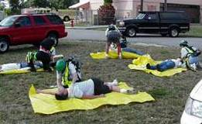
Order of Assessment
Head
Neck
Shoulders
Chest
Arms
Abdomen
Pelvis
Legs

Slide 3
Conducting Head-to-Toe Assessment
Pay careful attention
Look, listen, and feel
Check own hands for patient bleeding
If you suspect a spinal injury in unconscious survivors, treat accordingly
Check PMS in all extremities
Look for medical identification

Slide 4
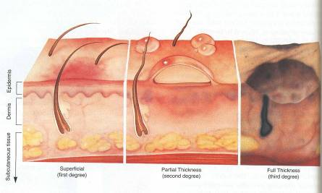
Burn Classifications
Superficial: epidermis
Partial Thickness: dermis and epidermis
Full Thickness: subcutaneous layer and all layers above

Slide 5
Splinting Guidelines
Support injured area above and below injury
Assess PMS in extremity
Splint injury in position that you find it
Don’t try to realign bones or joints
Fill voids to stabilize and immobilize
Immobilize above and below injury
After splinting, reassess PMS
Notes:
5

Slide 6
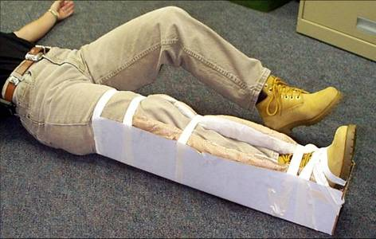
Splinting
Notes:
6

Slide 7
Triage Process
Step 1: Stop, Look, Listen, and Think
Step 2: Conduct voice triage
Step 3: Start where you stand; follow a systematic route
Step 4: Evaluate each survivor and tag
Step 5: Treat “I” survivors immediately
Step 6: Document triage results

Slide 8
Triage
Immediate (I): Survivor has life-threatening injuries (airway, bleeding, or shock)
Delayed (D): Injuries do not jeopardize survivor’s life; treatment can be delayed
Minor (M): Walking wounded and generally ambulatory
Dead (DEAD): No respiration after two attempts to open airway

Slide 9
Search Markings
Upon entering search area:
  Make a slash
  Enter info
Date
Time In
Time Out
CERT
I.D.
Areas Searched
Upon leaving search area:
  Complete ‘X’
  Enter info
Survivors
Notes:
9

Slide 10
Search Markings
What information do you mark?
Date
Time In
Time Out
CERT I.D.
Areas
Searched
Victims
Notes:
10

Slide 11
Search Markings
Example:
2/15/08
In: 1430
Out: 1515
FL 1-2 searched
Stairs to FL-3 unsafe
CERT-23
2L
Moved to
CERT-23 med
ops
Notes:
11

Slide 12
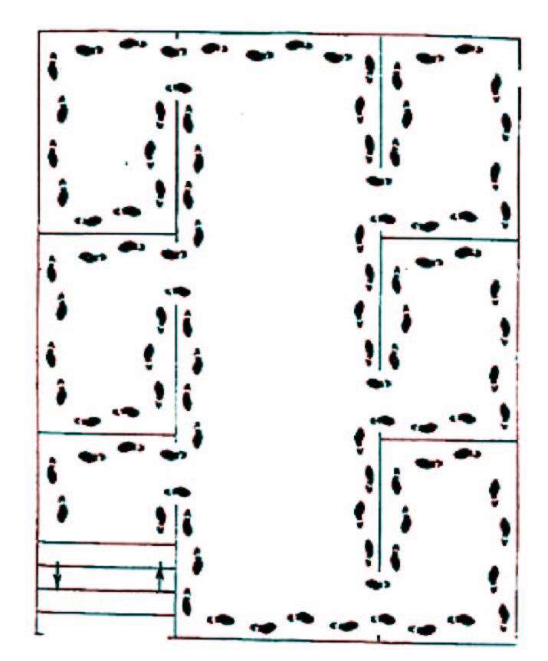
Search Methodology
Bottom-up/top-down for a multi-story building
Right wall/left wall for a single floor
Stop frequently to listen
Notes:
12

Slide 13
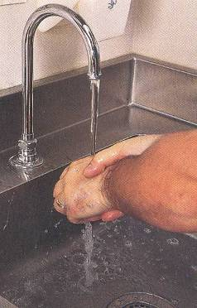
Search Basic Decontamination
Leave the contaminated area
Take decontamination action
  Remove everything
  Wash hands
  Flush the entire body
  Blot dry
Report for decontamination
Food safety

